Slide 1
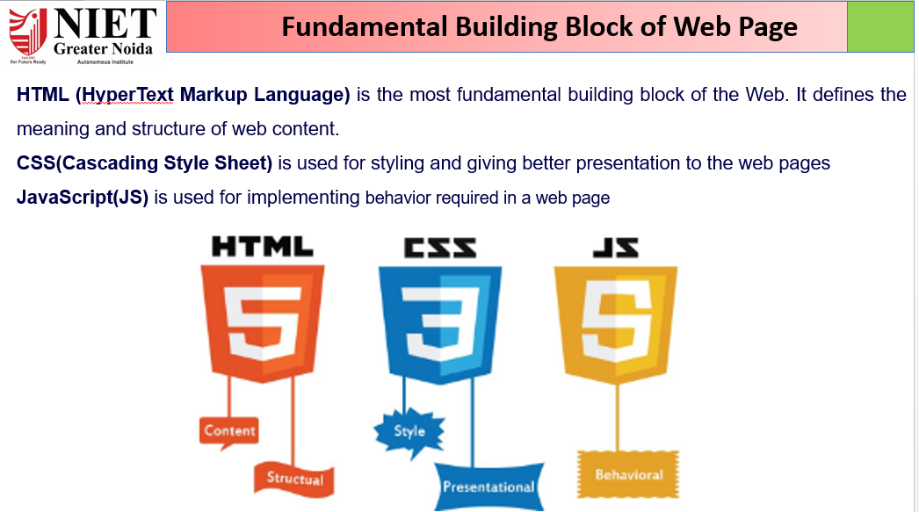
ABDUL KHALID KIT401 WD UNIT 3

Slide 2

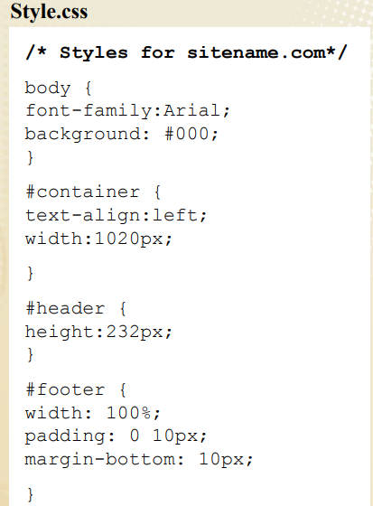
Cascading Style Sheets
CSS describes how HTML elements are to be displayed on screen, or in other media
CSS specifications are maintained by
World Wide Web Consortium (W3C).
CSS saves a lot of work. It can control the layout of multiple web pages all at once
External stylesheets are stored in CSS files Applies to (X)HTML as well as XML documents in general
Several versions of CSS exist:
CSS1, CSS2, CSS 2.1, and CSS3
ABDUL KHALID KIT401 WD UNIT 3

Slide 3
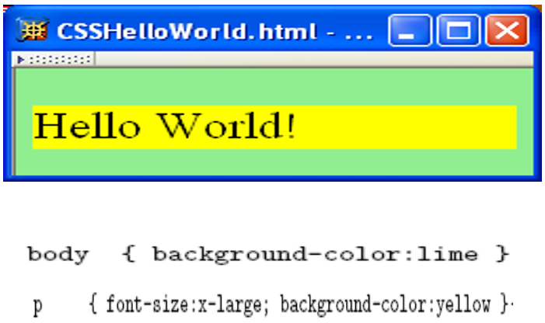
Cascading Style Sheets
ABDUL KHALID KIT401 WD UNIT 3

Slide 4
Cascading Style Sheets
CSS Benefits
• Separates structure from presentation
• Provides advanced control of presentation
• Easy maintenance of multiple pages
• Faster page loading
• Easy to learn
HTML & CSS
HTML and CSS work together to produce customized and efficient Web sites
• HTML = structure
• CSS = style
ABDUL KHALID KIT401 WD UNIT 3

Slide 5
Attaching a Style Sheet
There are 3 ways to attach CSS to a page:
1. External Style Sheet: Best used to control styling on multiple pages.
<link rel="stylesheet" type="text/css“ media="all" href="css/styles.css" />
2. Internal Style Sheet: Best used to control styling on one page.
<style type=“text/css”>
h1 {color: red)
</style>
3. Inline Style Sheet: CSS is not attached in the <header> but is used directly within HTML tags.
<p style=“color: red”>Some Text</p>
ABDUL KHALID KIT401 WD UNIT 3

Slide 6
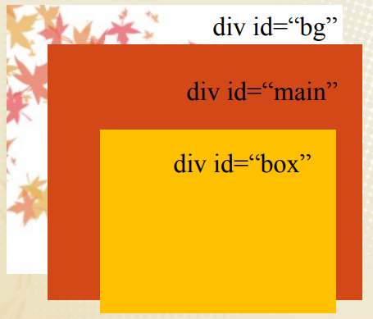
Including Images Background
Properties for working with images include:
• Background-image
• Background-repeat
• Background-position
• Background-attachment
Background colors and images are
layered like sheets of paper one on
top of the other.
#bg {background:url(leaves.jpg)
no-repeat top left}
#main {background-color: red}
#box {background-color: yellow}
ABDUL KHALID KIT401 WD UNIT 3

Slide 7
Background Image
1. Background-image, Background-repeat are two properties that you can use to specify a background color in a web page (True/False)
2. The value repeat-x causes a background image to be tiled only along the x-axis (Yes/No)
3. Background-attachment can you use to turn off tiling of a background image (True/False)
4. Background-repeat set an image ten pixels from the left and ten pixels from the top (True/Fale)
5. The background-attachment property specifies whether the background image should scroll or be fixed (Yes/No)
ABDUL KHALID KIT401 WD UNIT 3

Slide 8
CSS List
We have the following five CSS properties, which can be used to control lists:-
The list-style-type allows you to control the shape or appearance of the marker.
The list-style-position specifies whether a long point that wraps to a second line should align with the first line or start underneath the start of the marker.
The list-style-image specifies an image for the marker rather than a bullet point or number.
The list-style serves as shorthand for the preceding properties.
The marker-offset specifies the distance between a marker and the text in the list.
ABDUL KHALID KIT401 WD UNIT 3

Slide 9
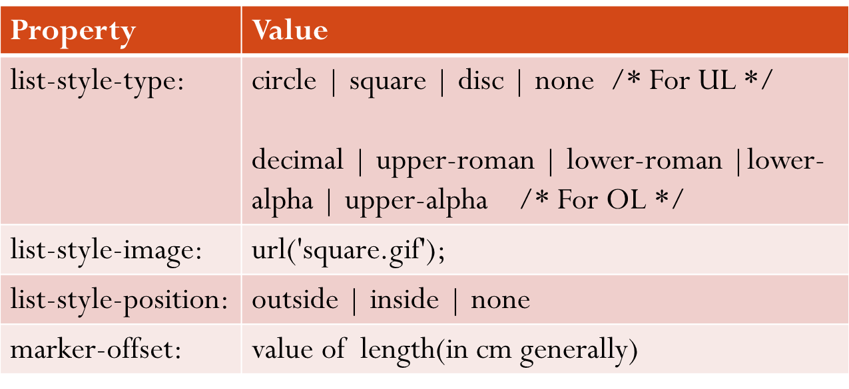
CSS List
ABDUL KHALID KIT401 WD UNIT 3

Slide 10
CSS Tables: Layout
table-border: specifies border for table, th or tr
table-width: specifies width of table, th or tr
table-height: specifies height of table, th or tr
text-align: horizontal alignment of text as: left|right|center
vertical-align: alignment of content in th or td as: top|bottom|middle
padding: to control the space between the border & the content
border-bottom: for horizontal dividers applied to th or td
tr:hover: to highlight table rows on mouse over, applied on tr
Striped tables: For zebra-striped tables, use the nth-child() selector and add a background-color to all even (or odd) table rows
background-color: of table, th or tr
ABDUL KHALID KIT401 WD UNIT 3

Slide 11
CSS Table Properties
The border-collapse specifies whether the browser should control the appearance of the adjacent borders that touch each other or whether each cell should maintain its style.
The border-spacing specifies the width that should appear between table cells.
The caption-side captions are presented in the <caption> element. By default, these are rendered above the table in the document. You use the caption-side property to control the placement of the table caption.
The empty-cells specifies whether the border should be shown if a cell is empty. Values it can have: show|hide|inherit
ABDUL KHALID KIT401 WD UNIT 3

Slide 12
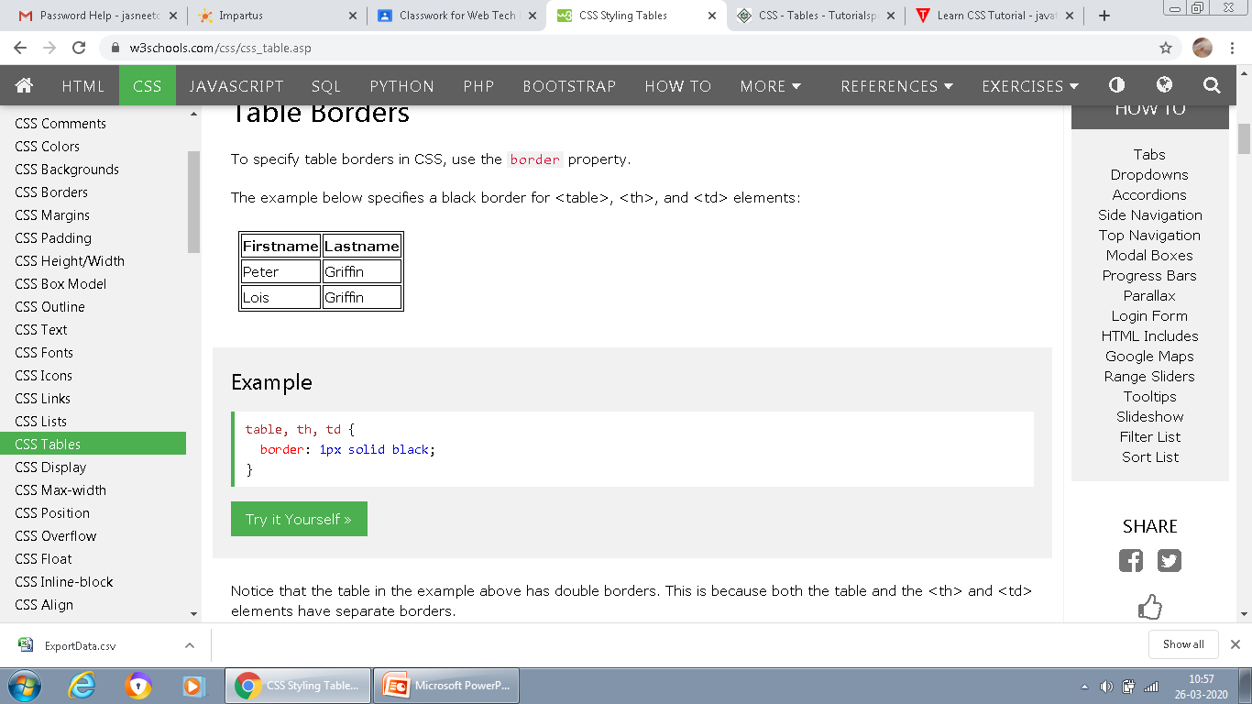
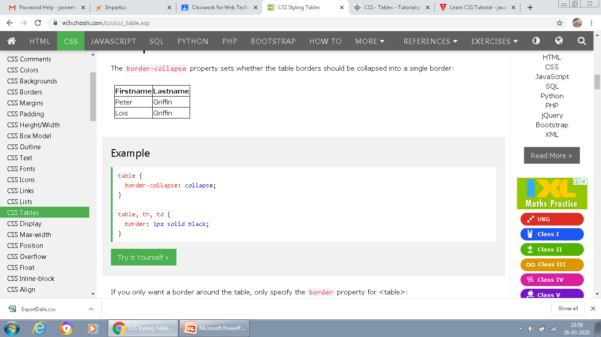
Table-collapse property
table, th, td {
border: 1px solid black;
}
table {
border-collapse: collapse;
}
ABDUL KHALID KIT401 WD UNIT 3

Slide 13
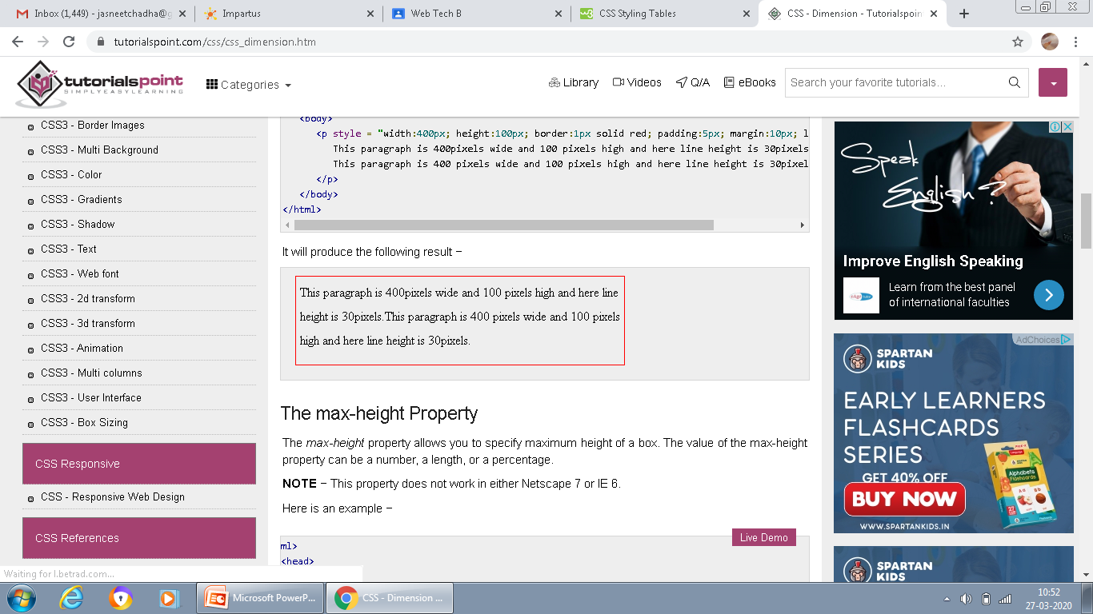
CSS Advanced-Dimension
height & width property is used to set the height & width of a box.
line-height property is used to set the height of a line of text.
max-height property is used to set a maximum height that a box can be.
min-height property is used to set the minimum height of a box.
max-width property is used to set the maximum width of a box.
min-width property is used to set the minimum width that a box can be.
ABDUL KHALID KIT401 WD UNIT 3

Slide 14
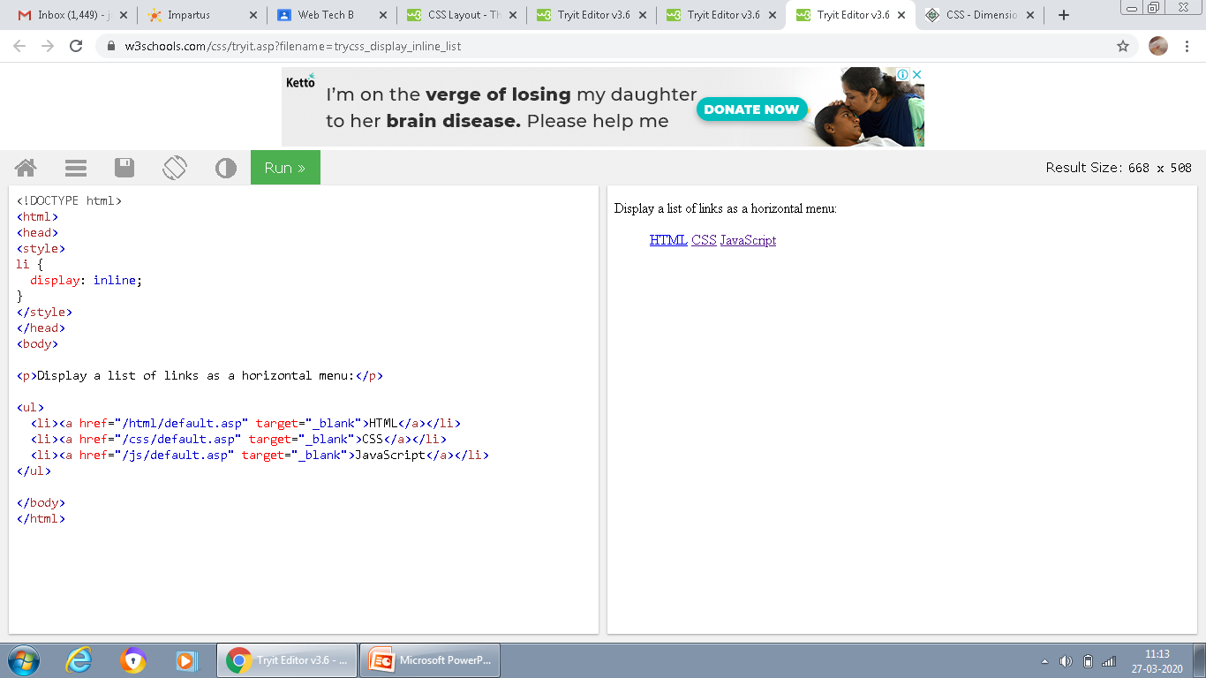
CSS Advanced – Display
The display property specifies how an element is displayed.
Every HTML element has a default display value depending on what type of element it is. The default display value for most elements is block or inline.
A block-level element always starts on a new line and takes up the full width available (stretches out to the left and right as far as it can). Eg: div, h1 – h6, p
An inline element does not start on a new line and only takes up as much width as necessary. Eg: a, img
ABDUL KHALID KIT401 WD UNIT 3

Slide 15
CSS advanced- float
The float property is used for positioning and formatting content e.g. let an image float left to the text in a container.
The float property can have one of the following values:
left - The element floats to the left of its container
right - The element floats to the right of its container
none - The element does not float (will be displayed just where it occurs in the text). This is default
inherit - The element inherits the float value of its parent
In its simplest use, the float property can be used to wrap text around images.
ABDUL KHALID KIT401 WD UNIT 3

Slide 16
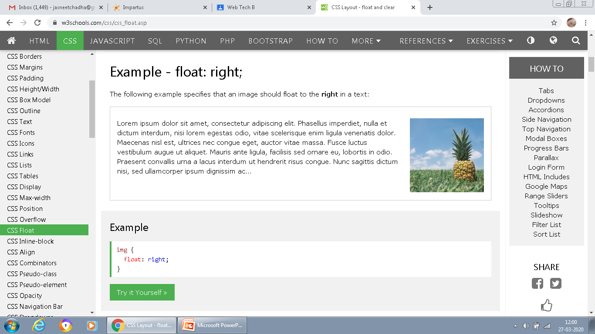
CSS advanced- float
ABDUL KHALID KIT401 WD UNIT 3

Slide 17
CSS Advanced- Positioning
The five different position values of element:
Static: It is not positioned in any special way; it is always positioned according to the normal flow of the page:
Relative: It is positioned relative to its normal position. Setting the top, right, bottom, and left properties of a relatively-positioned element will cause it to be adjusted away from its normal position.
Fixed: It is positioned relative to the viewport, which means it always stays in the same place even if the page is scrolled.
Absolute: It is positioned relative to the nearest positioned ancestor.
Sticky: A sticky element toggles between relative and fixed, depending on the scroll position. It is positioned relative until a given offset position is met in the viewport - then it "sticks" in place (like position:fixed).
ABDUL KHALID KIT401 WD UNIT 3

Slide 18
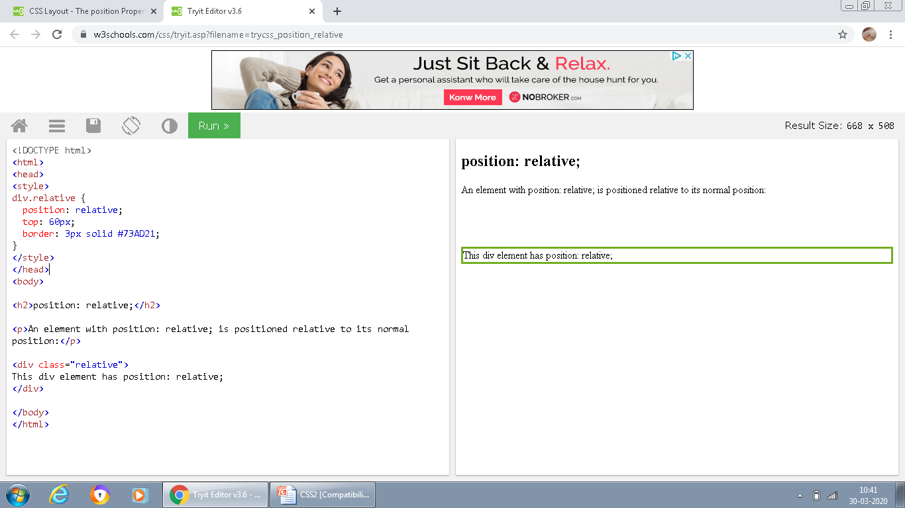
CSS Advanced- Positioning
<style>
div.relative {
position: relative;
top: 60px;
border: 3px solid #73AD21;
}
</style>
ABDUL KHALID KIT401 WD UNIT 3

Slide 19

Image Sprites
An image sprite is a collection of images put into a single image.
A web page with many images can take a long time to load and generates multiple server requests.
Instead of using three separate images, we use this single image ("img_navsprites.gif"):
With CSS, we can show just the part of the image we need.
ABDUL KHALID KIT401 WD UNIT 3

Slide 20
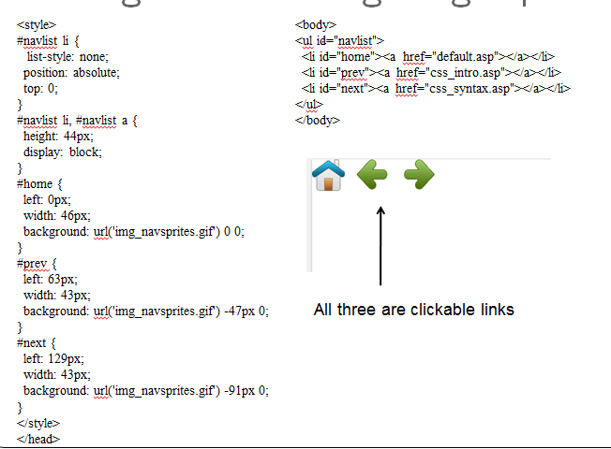
Navigation Bar using Image Sprites
ABDUL KHALID KIT401 WD UNIT 3

